Slide 1
Module 2
Cyber Frauds and Security Issues

Slide 2
Social Engineering
Social engineering involves gathering secret information as well as unauthorized access of network.
Classification of social engineering.
1. Human Based 2. Computer Based.
Human –Based social engineering.
- Impersonating an employee or valid user. (organization having various branch)
- Using third person : An attacker pretends to have permission from authorized
user to access the system.
- Calling technical support .(Technical Support staff)
- Shoulder surfing (login id/password)
Computer Based Social Engineering.
- sensitive or confidential information is collected by using computer
/Internet.
1. Fake E-mail : Attacker sends fake email to no of users. victim find it legitimate mail.
2. E-mail Attachment. (malicious code is attached )
3. Pop up windows. – special offers.

Slide 3
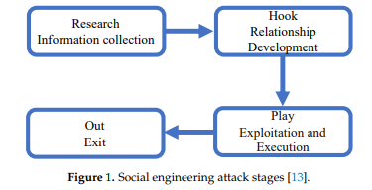
Social Engineering

Slide 4
Cyber stalking
Use of information and communication technology by individuals or group of individuals to harass another individual, group of individuals or organizations.
It includes
- false accusations/allegations
- monitoring
- transmission of threats
- ID thefts
-damage to data or equipment

Slide 5
Cyberstalking
Stalking means “act or process of following victim silently”
Types of stalking
1. Online stalking : They interact with victim directly with the help of Internet.
Mode of Interaction : E-mail, chat room, traditional PSTN
,VoIP phones.
Stalker can make use of third party to harass victim.
2. offline stalker : Stalker may attack on victim by observing his
1. Daily routing.
2. searching personal website /blogs
3. Visiting victim organization.

Slide 6
Kinds of cyber stalking
E-mail stalking
Internet stalking
Computer Stalking
Motives behind Cyber stalking:
Harassment
Fascination
Revenge
Boasting or showoff

Slide 7
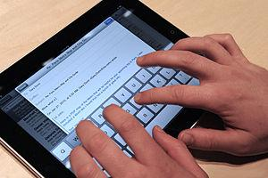
Cybercafe and Cybercrime
Tips for safety and security while using the computer in a cybercafe.
- Always logout.
- Stay with the computer.
- Clear history and temporary file.
- Be alert.
- Avoid online financial transaction.
- change password.
- Virtual keyboard ( icici bank provides it to enter secret
pin/3D secure code / credit card no.)
- Security warning : warning should consider during accessing financial
/banking site.

Slide 8
Bullying in Cyberspace
Cyber bullying is when the Internet and related technologies are used to bully other people, in a deliberate, repeated, and hostile manner.
This could be done via
1. text messages or images,
2. personal remarks posted online,
3. hate speeches,
4. instigating others to dislike and gang up on the target by making them the subject of ridicule in forums, and
5. posting false statements in order to humiliate or embarrass another person. Cyberbullies may also disclose victims' personal data (e.g. real name, address, or workplace/schools) on websites.

Slide 9
Botnet : Fuel for cybercrime
Bot is an automated program which are responsible to perform specific task over network.
Botnet : A botnet is a network of inflected computer that allow attacker to control machine remotely .
Botnet use for business.
Gainful purposes of botnets:
Botnet creation:
1. Botnet Renting
2. Botnet selling
-DDoS Attack
-Spam Attack
-Malware and Adware Installation
-Stealing confidential information

Slide 10
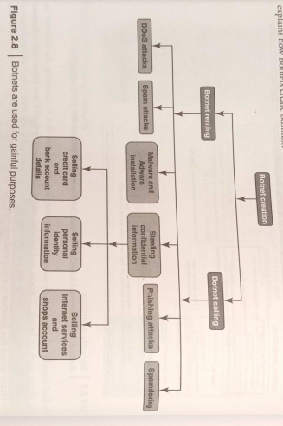
diagram

Slide 11
-Phishing Attack
-Spamdexing { search engine poisoning } (It is the deliberate manipulation of search engine indexes.)
Stealing confidential information :
1. Selling credit card and bank account details.
2. Selling personal identity info.
3.Selling internet service and shop account.

Slide 12
Attack Vector
An attack vector is a path or means by which an attacker can gain access to a computer or to network server to deliver a payload. ( malicious code )
Attack vector include virus , E-mail attachment, web page, pop up window, instant message , chat room .
To some extend , attack vector can be block using firewalls and antivirus.
List of attack vector
1. Attack by email.
2. Attachment.
3.Attack by deception (trick)
4. Hackers
5. Heedless guest (attack by webpage ) : attacker make fake website to extract
personal information , such website look genuine .

Slide 13
Attack Vector
6. Attack of the worms.
Many worms are deliver as E mail attachment.
worms are using holes of network protocol ( Provides list of flaws )
7. Malicious macros : MS word and MS excel.
8. Foistware : Foistware is the software that adds hidden components to the system on the sly (smartly or clever). It is bundle with attractive software.
9. Virus

Slide 14
2.2 Cloud Computing
Concept of cloud computing.
E-mail, Project data hosting and accessing.
Cloud Computing is a technology that uses the internet and central remote servers to maintain data and applications.
Businesses that cannot afford the same amount of hardware and storage space as a bigger company. Small companies can store their information in the cloud, removing the cost of purchasing and storing memory devices
To access the cloud user should have internet connection.

Slide 15
Characteristics of cloud computing
It is sold on demand.
It is elastic in terms of usage
The service is fully managed by the provider.

Slide 16
Advantages of cloud computing:
Accessed from anywhere anytime.
Reduces hardware cost.
No need to buy set of software or software licenses for every employee.
Do not have to rent a physical space to store server and databases.
Save many on IT support.

Slide 17
Types of clouds
There are different types of clouds that you can subscribe to depending on your needs. As a home user or small business owner, you will most likely use public cloud services.
1. Public Cloud - A public cloud can be accessed by any subscriber with an internet connection and access to the cloud space.
2. Private Cloud - A private cloud is established for a specific group or organization and limits access to just that group.
3. Community Cloud - A community cloud is shared among two or more organizations that have similar cloud requirements.

Slide 18
4. Hybrid Cloud - A hybrid cloud is essentially a combination of at least two clouds, where the clouds included are a mixture of public, private, or community.

Slide 19
Types of services:
Infrastructure as a Service (IaaS)
-provides virtual services with unique IP addr and blocks of storage on demand.
-API-users control their servers.
-also called as ‘utility computing’
Platform as a service (PaaS)
-set of software or development tools
-user can create application using providers API
Google Apps is most famous PaaS provider.

Slide 20
3. Software as a Service:
-Broadest market
-allow to use its applications only
-software interacts with user through user interface
-web based e-mail, twitter,etc

Slide 21
Cyber crime and cloud computing
Very important to protect data.
Risks involved are
Elevated user access
Regulatory compliance
Location of data
Segregation of data
Recovery of data
Information security violation reports
Long term viability

Slide 22
4. Spoofed policy development process (PDP)
5. Signaling level attacks

Slide 23
Key findings in mobile computing security scenario
-users get enhanced
-people-weakest link-laptop security
Concern over choosing appropriate device

Slide 24
Credit card frauds in mobile and wireless computing era
New trends coming with mobile computing- m-commerce, m-banking.
Reason- increasing power, reducing cost
Mobile credit card transactions are very common since it allows transaction from mobile location quickly, efficiently and professionally.

Slide 25
Flow of transaction using credit card
Merchant send transaction to bank
bank request to authorized card holder (sms)
Card holder approve or rejects transaction(password protected)
Bank/merchant is notified
Credit card transaction is completed

Slide 26
Types and techniques of credit card frauds
Traditional Techniques
Paper based fraud- application fraud (stolen/ fake documents)
A. ID theft
B. financial fraud
2. Modern techniques
Sophisticated techniques(enable criminals to produce fake cards)
-skimming- information on magnetic stripe/ smart chip are copied from one card to other car
site cloning and false merchant sites on internet (direct users to such bogus/ fake sites –phishing)
Triangulation
Credit card generation

